Slide 1


By: Sayfiddinova Bonu
Teacher:
Maksudxo'jayev Muhammad Sodiq
Types of
BUSINESS

Slide 2

Table of
CONTENTS
01
02
03
04
Introduction (Cont'd)
Sole Proprietorship
Partnership
Corporation
05
06
07
08
Limited Liability Company (LLC)
E-commerce Business
Franchise
Conclusion

Slide 3

INTRODUCTION
The business landscape is multifaceted, ranging from small sole proprietorships to multinational corporations. Each type of business structure has its unique features, offering a spectrum of choices for individuals and entities to tailor their approach to commerce.

Slide 4

SOLE
Our journey begins with the simplest form of business: Sole Proprietorship. This structure involves a single individual owning and operating the business. The advantages include simplicity in decision-making and full control over operations. However, it comes with unlimited liability, meaning the owner is personally responsible for any debts or liabilities.
PARTNERSHIP

Slide 5

PARTNERSHIP
PARTNERSHIP
Next on our journey is the Corporation, a distinct legal entity separate from its owners (shareholders). Corporations offer limited liability, meaning shareholders' personal assets are protected from the company's debts. They have centralized management and enjoy perpetual existence, making them suitable for large-scale operations. There are different types of corporations, including C-corporations and S-corporations, each with its tax implications.
Moving on, we explore Partnership, where two or more individuals share ownership and responsibilities. There are two main types: general partnership, where partners share equally in responsibilities and liabilities, and limited partnership, where one partner has limited liability. Partnerships are often found in professional services like law firms and accounting practices.

Slide 6

Limited Liability
COMPANY (LLC)
A more flexible option is the Limited Liability Company (LLC), combining the benefits of both partnerships and corporations. LLCs offer limited liability to their members (owners) while allowing a more flexible management structure and pass-through taxation, where profits and losses flow through to the members' personal tax returns.

Slide 7
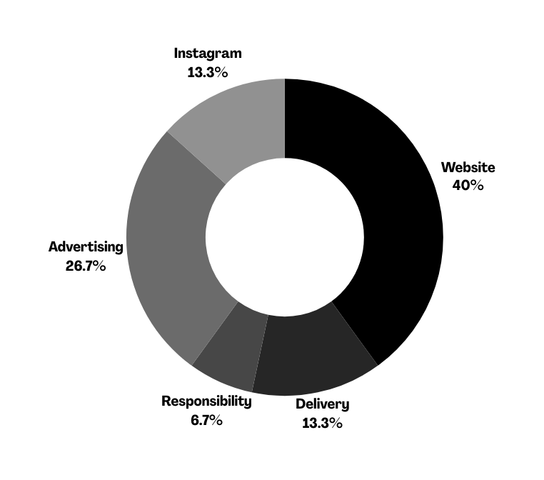
E-Commerce
BUSINESS
Moving on, we explore Partnership, where two or more individuals share ownership and responsibilities. There are two main types: general partnership, where partners share equally in responsibilities and liabilities, and limited partnership, where one partner has limited liability. Partnerships are often found in professional services like law firms and accounting practices.

Slide 8


Franchise
The Franchise model involves an individual (franchisee) operating a business using the branding and support of a larger company (franchisor). This model provides a proven business concept, ongoing support, and a recognized brand. Familiar examples include McDonald's and Subway.

Slide 9
Conclusion
In conclusion, the world of business is rich and varied, offering a multitude of options for individuals and entities to engage in commerce. Choosing the right business structure is a critical decision, impacting aspects such as liability, management, and taxation. Whether you are a budding entrepreneur or an investor, understanding these various business types is essential for success.

Slide 10


THANK YOU!
Thank you for joining us on this exploration of the various types of businesses. Your understanding of these structures will undoubtedly empower you as you navigate the exciting and ever-changing world of business. Best of luck on your entrepreneurial journey!

